Slide 1




Symmetric Cryptography Lab
Hacking Crypto vulnerabilities
by : …………………………………
……………………………………….
📧 ……………………………….

Slide 2
Agenda
Introduction
Lab setup
Lab 01: Block size detection
Lab 02: Mode detection
Lab 03: ECB byte at a time
Lab 04: CBC IV detection
Lab 05: CBC bit flipping
Lab 06: CBC byte at a time
Lab 07: CBC padding
Lab 08: CTR Bit flipping

Slide 3
Introduction
Dedicated to the exploration and analysis of cryptographic configuration and implementation vulnerabilities
Aimed at enhancing the robustness and integrity of cryptographic systems.
Includes 8 unique and comprehensive labs
This lab focusses on the offensive techniques used by red teams to crack the cryptographic systems

Slide 4


Lab Setup
The lab have 2 sides
Attacker side (uses python scripts to attack the crypto system)
Victim side ( uses a web server to run his own system)
For the attacker side we will use python3 to communicate with the victim’s server and run the exploitation scripts we wrote
The victim runs his own system over flask webserver over docker container
We will install and run both the attacker and victim side tools and start to exploit it
Victim side
Attacker side

Slide 5

Install victim side
Download and install docker for desktop docker.com/products/docker-desktop/
Now you have 2 ways to build and run the victims server
Build from scratch download the lab folders from github MohamedSalahElden/EmbeddedSecurity: embedded security cources (github.com) go to Cryptography/Symmetric Crypto/Labs/implementation folder open the CMD then build the image docker build -t cryptolab . Now you can run the container and expose the port number docker run -d -p 5000:5000 cryptolab
Download and run from docker hub mohamedsalah5369/cryptolab - Docker Image | Docker Hub or pull it from CMD docker pull mohamedsalah5369/cryptolab then you can run it from CMD docker run -d -p 5000:5000 mohamedsalah5369/cryptolab:latest
Docker container

Slide 6


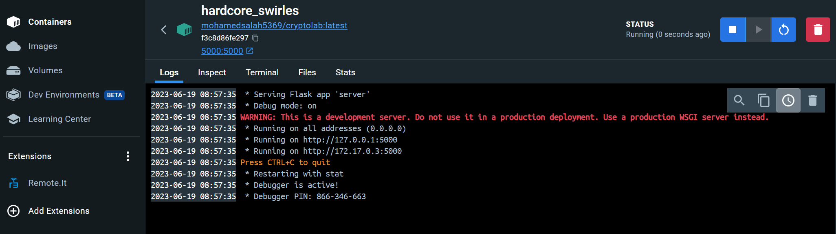
Install victim side
You can verify that the server is up and running by hitting to docker desktop and go to containers tab to see your container is running

Slide 7

Install the attacker side
For the attacker side we will use python3 to write the attack script
It is preferred to use project Jupyter to run cascaded attacks https://jupyter.org/

Slide 8

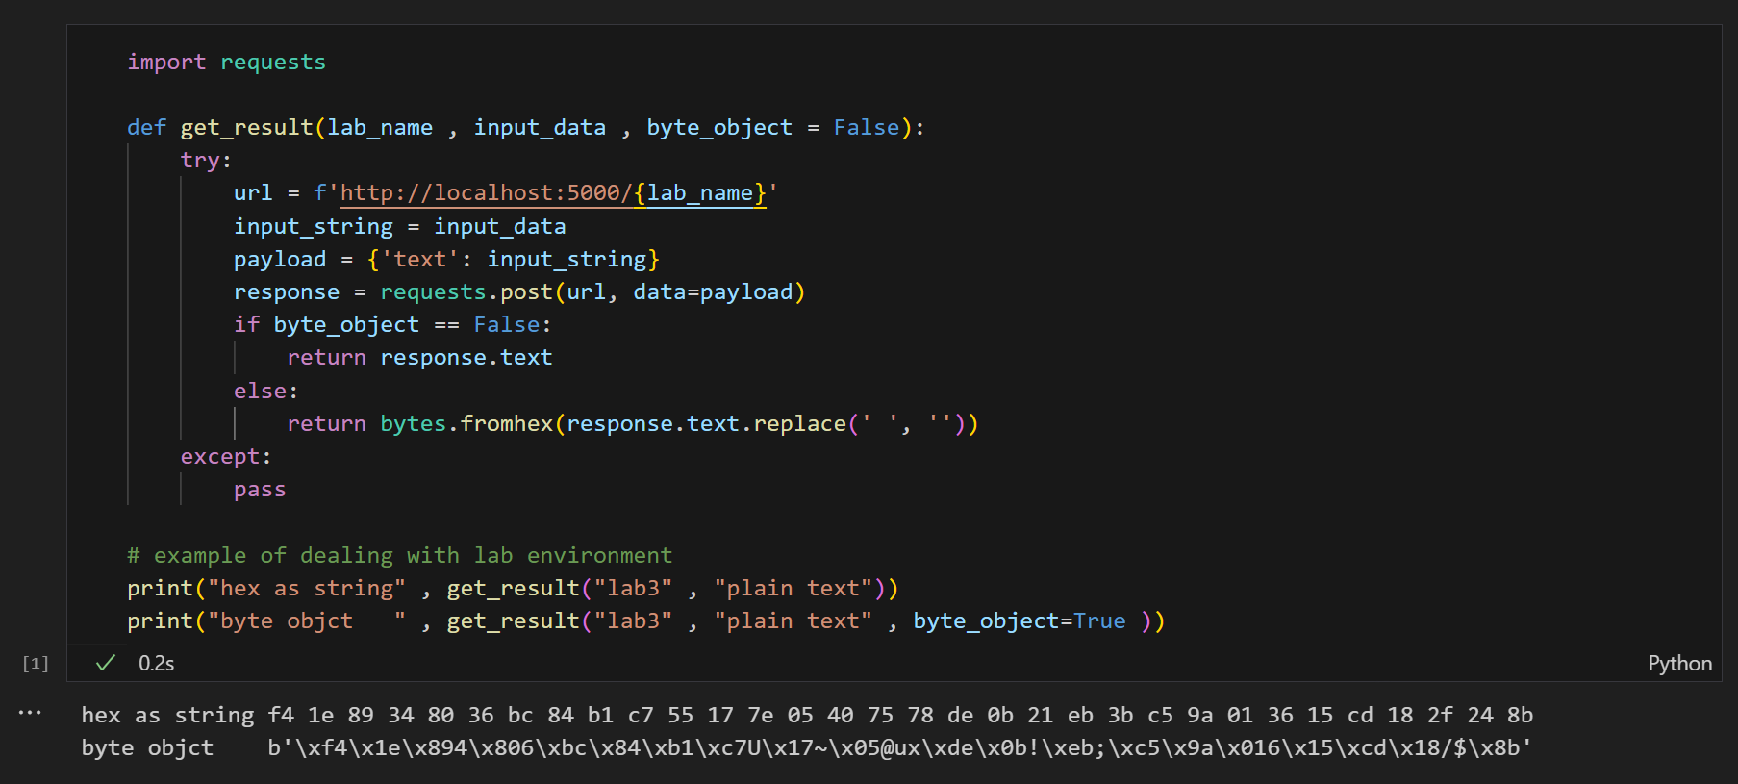
Test Communication
To test the communication to the server we will write a function that uses requests library to send strings to the server and get the response.

Slide 9
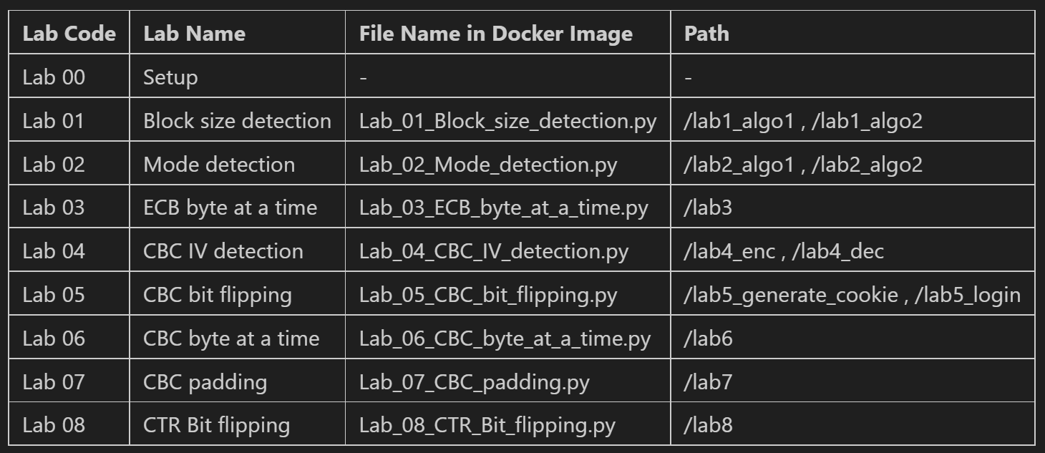
Lab pathes
The labs are structured as paths in the server

Slide 10
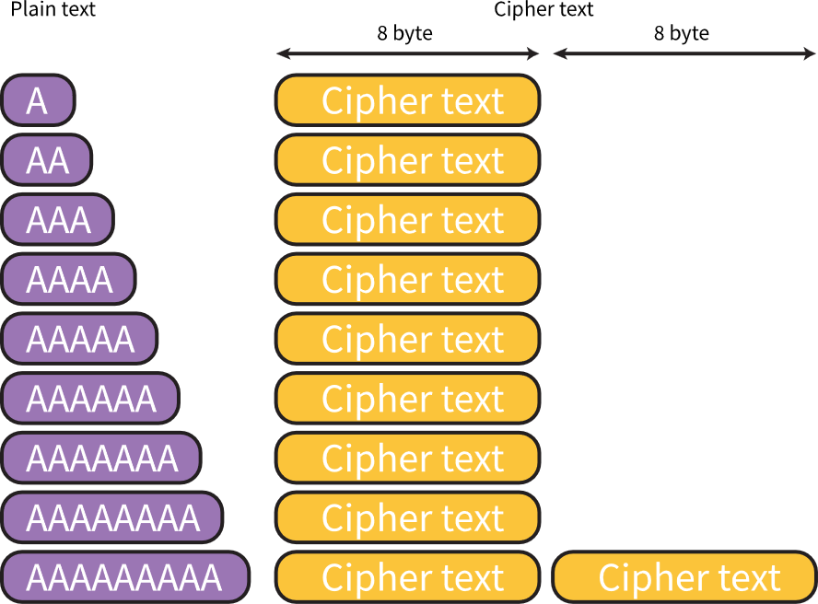
Lab 01: Block size detection
Given
The mode for encryption A standard block cipher encryption is used Encryption function
Needed
find out the size of block used
Exploitation
Encrypt one byte at a time and notice the cipher size resulted from encryption operation If the cipher text increases one block subtract the new cipher text size from the old cipher text size to get the block size of this algorithem

Slide 11
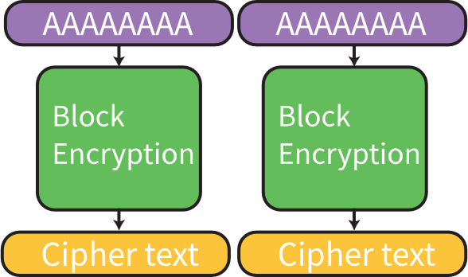
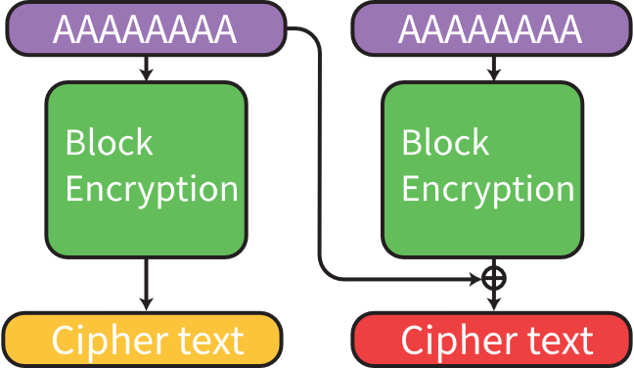
Lab 02: Mode detection
Given
A standard block cipher encryption is used Encryption function
Needed
find out the mode of operation either it is an ECB mode or Non-ECB mode
Exploitation
By sending 2 identical plain text blocks with size of the block size of the algorithm and see the resulted cipher text blocks If the 2 cipher blocks are identical then this is ECB mode of encryption Otherwise it is not ECB
ECB mode
Non-ECB mode

Slide 12
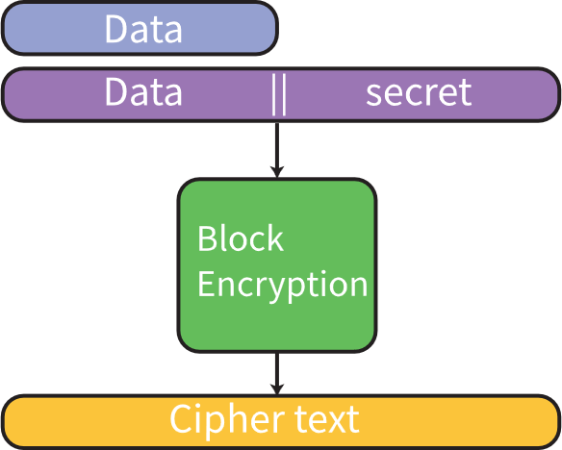
Lab 03: ECB byte at a time
Given
A standard block cipher encryption is used Scenario The user sends the data to the server The server appends a secret string to the data Then encrypt the string and return the cipher text
Needed
Find out the secret string appended to the data
Exploitation

Slide 13
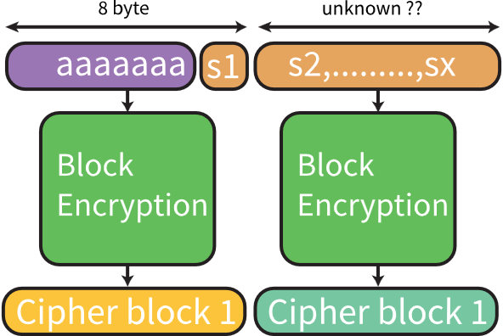
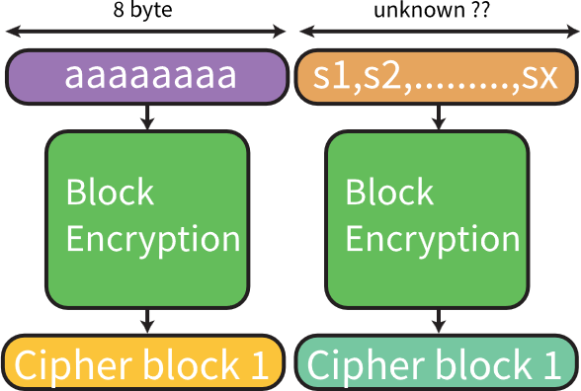
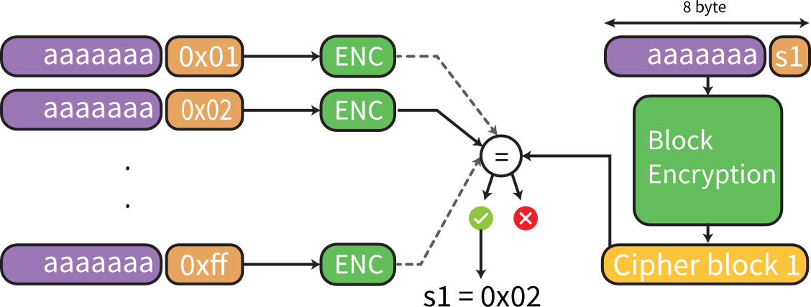
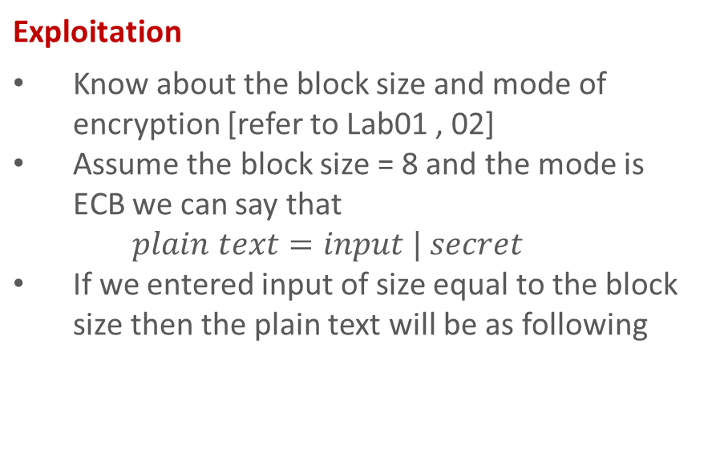
Lab 03: ECB byte at a time
Exploitation
Know about the block size and mode of encryption [refer to Lab01 , 02] Assume the block size = 8 and the mode is ECB we can say that $plain text=input | secret$ If we entered input of size equal to the block size then the plain text will be as following
Now if we input the same input but without the last byte Then we can brute force s1 to get the correct value that leads to the same cipher block 1

Slide 14
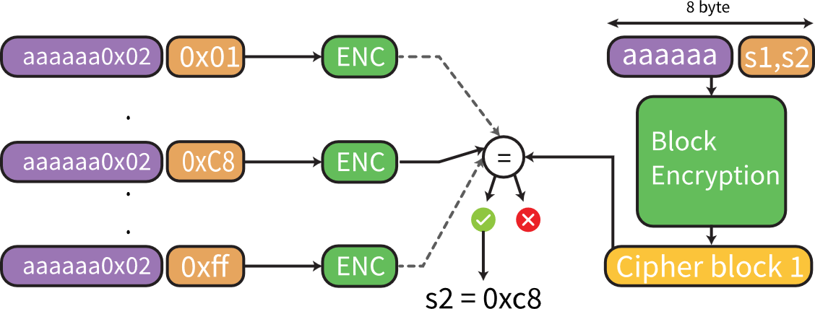
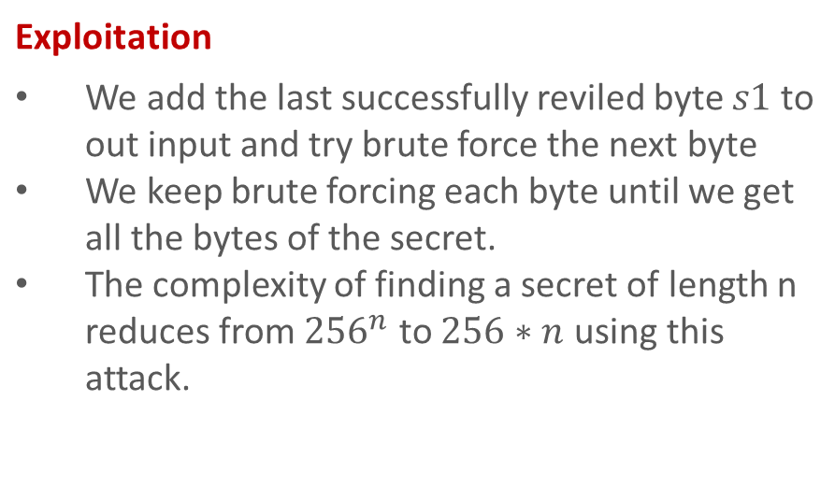
Lab 03: ECB byte at a time
Exploitation
We add the last successfully reviled byte $s1$ to out input and try brute force the next byte We keep brute forcing each byte until we get all the bytes of the secret. The complexity of finding a secret of length n reduces from ${256}^{n}$ to $256∗n$ using this attack.

Slide 15
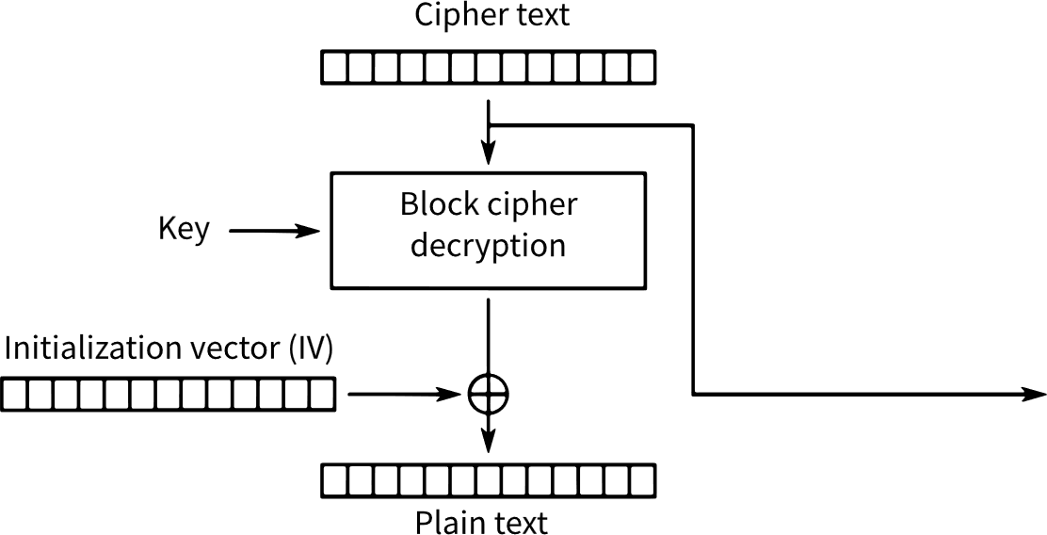

Lab 04: CBC IV detection
Given
A standard block cipher encryption is used CBC mode of operation cryptography system Scenario The server encrypts/decrypts data given to it as an input. The encryption/decryption is based on a block cipher in CBC mode.
Needed
find out value of the Initialization vector IV in CBC mode
$$iv$$

Slide 16
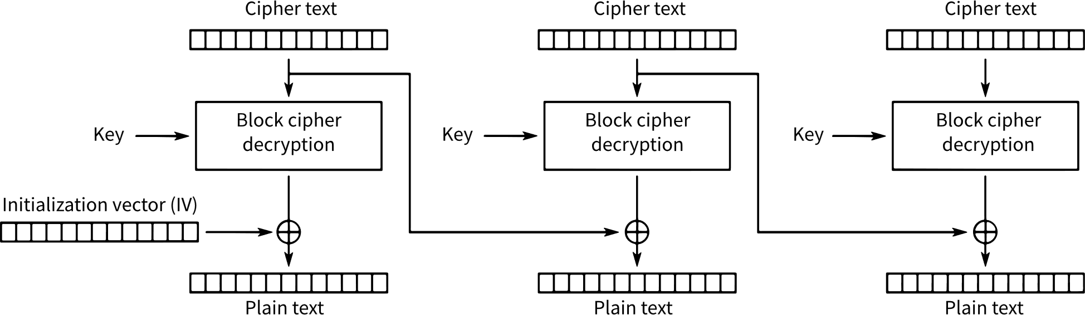
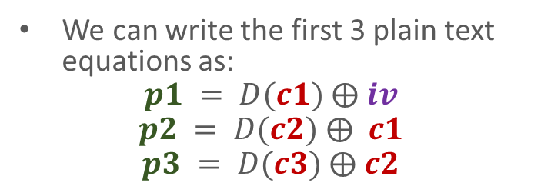

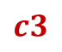
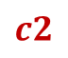
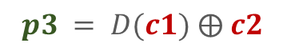

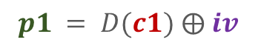
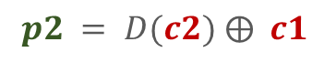
Lab 04: CBC IV detection
We can write the first 3 plain text equations as:
$$p1 = D(c1) ⨁ iv$$
$$p2 = D(c2) ⨁ c1$$
$$p3 = D(c3) ⨁ c2$$
Exploitation
For this attack, we will select first three blocks of ciphertext because IV is directly used in the first block.
$$c1$$
$$c2$$
$$c3$$
$$iv$$
$$p1 = D(c1) ⨁ iv$$
$$p2 = D(c2) ⨁ c1$$
$$p3 = D(c1) ⨁ c2$$

Slide 17



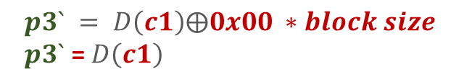
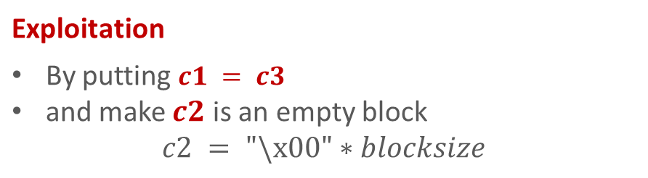

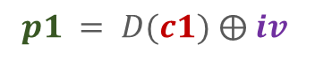
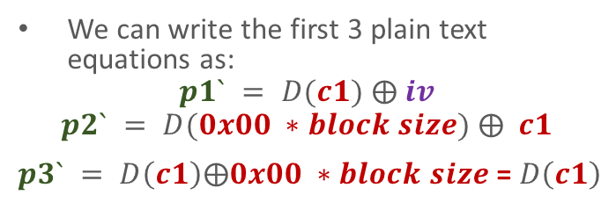

Lab 04: CBC IV detection
We can write the first 3 plain text equations as:
$$p1` = D(c1) ⨁ iv$$
$$p2` = D(0x00 ∗block size) ⨁ c1$$
$p3` = D\left(c1\right)⨁0x00 ∗block size$ = $D\left(c1\right)$
Exploitation
By putting $c1 = c3$ and make $c2$ is an empty block $c2 = "\backslash x00"∗blocksize$
$$c1$$
$$0x00 ∗block size$$
$$c1$$
$$iv$$
$$p3` = D\left(c1\right)⨁0x00 ∗block size \\ p3` \text{= }D\left(c1\right)$$
$$p1 = D(c1) ⨁ iv$$
$$p2` = D(0x00 ∗block size) ⨁ c1$$
Substituting in $p1$ equation

Slide 18


Lab 04: CBC IV detection
Exploitation
We will get Then
$$p1` =p3` ⨁ iv$$
$$iv= p1`⨁p3`$$

Slide 19
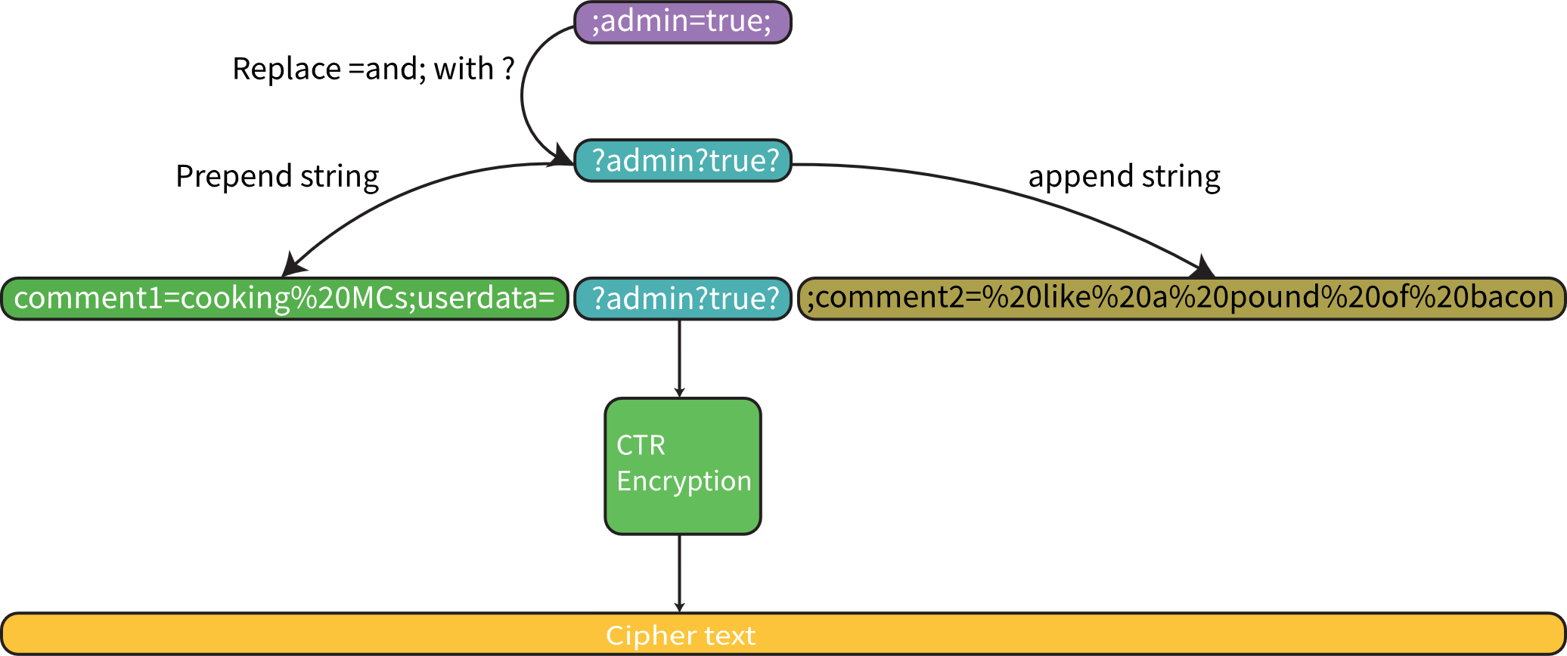
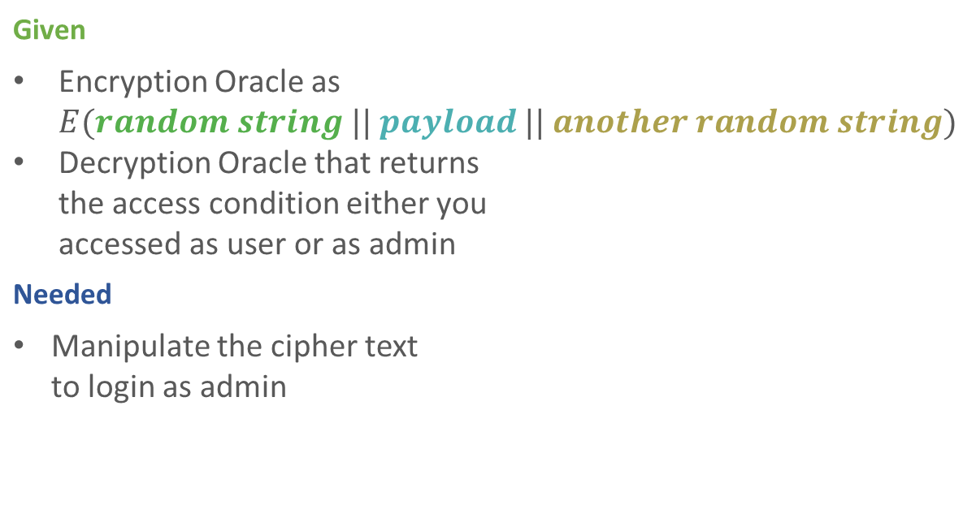
Lab 05: CBC bit flipping
Given
Encryption Oracle as $E(random string || payload || another random string)$ Decryption Oracle that returns the access condition either you accessed as user or as admin
Needed
Manipulate the cipher text to login as admin

Slide 20
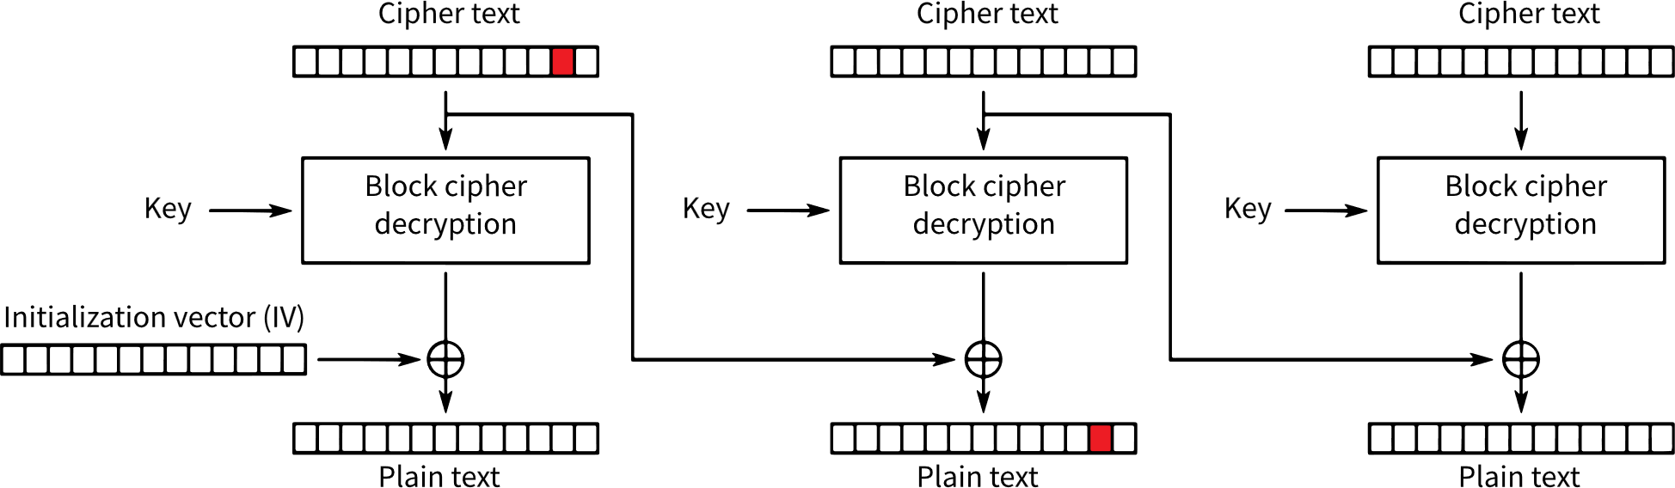
Lab 05: CBC bit flipping
Exploitation
We have control over the cipher text we send to the login function If we have a way to manipulate this cipher text in a way that changes the resulted plain text after decryption we can access as admin
Manipulated location
Resulted plain text after manipulation

Slide 21

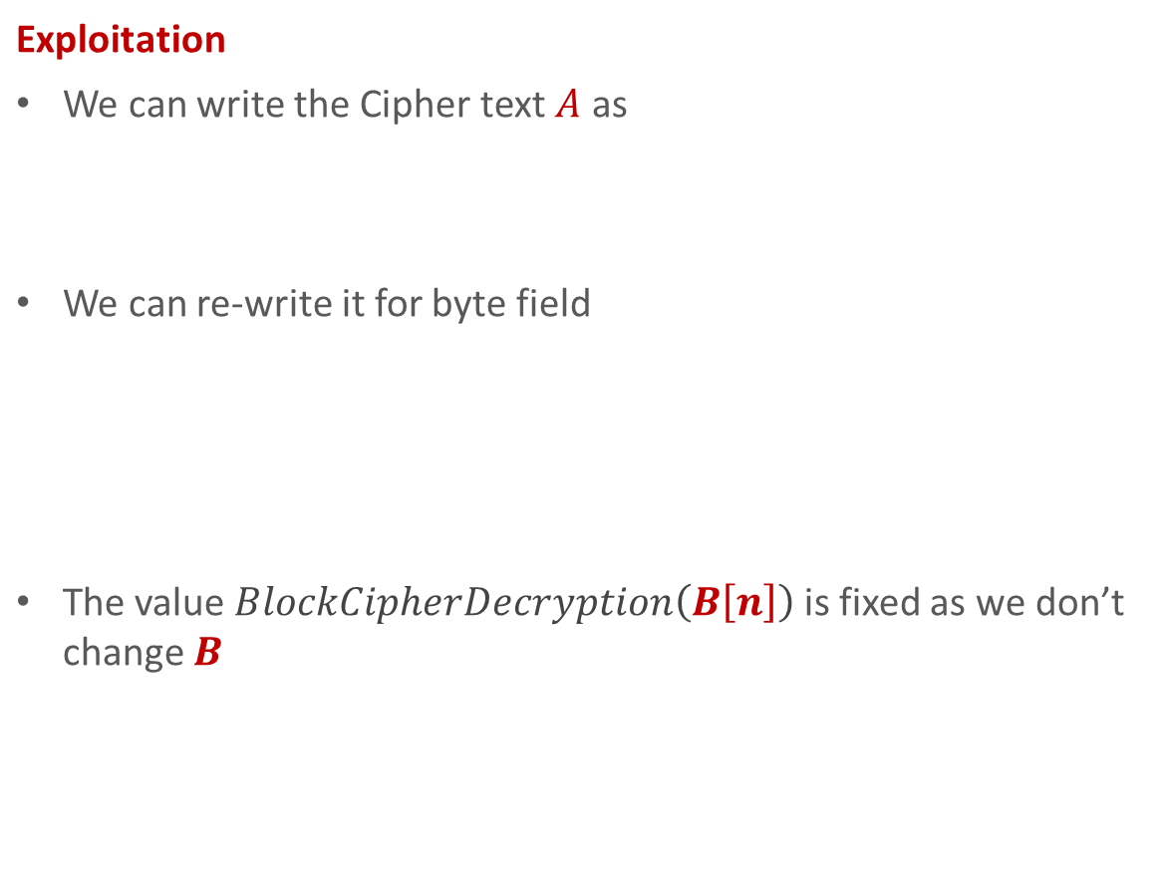


Lab 05: CBC bit flipping
Manipulated location
Exploitation
We can write the Cipher text $A$ as We can re-write it for byte field The value $BlockCipherDecryption\left(B\left[n\right]\right)$ is fixed as we don’t change $B$
$$A$$
$$B$$
$$A = P⨁BlockCipherDecryption(B)$$
$$A[n] = P[n]⨁BlockCipherDecryption(B[n])$$
$$P$$
$$BlockCipherDecryption\left(B\left[n\right]\right)=A[n]⨁P[n]$$
Resulted plain text after manipulation

Slide 22

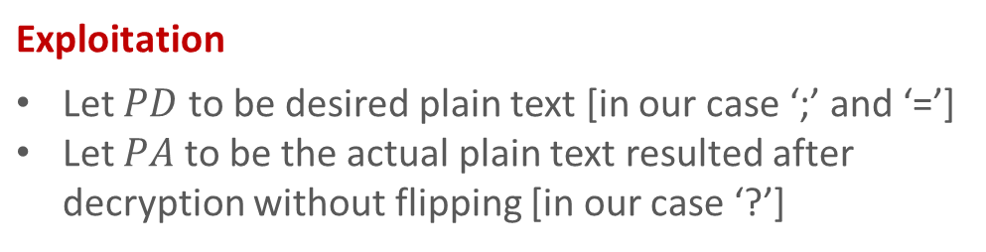
Lab 05: CBC bit flipping
Manipulated location
Exploitation
Let $PD$ to be desired plain text [in our case ‘;’ and ‘=’] Let $PA$ to be the actual plain text resulted after decryption without flipping [in our case ‘?’]
$$A$$
$$B$$
$$A`[n] \text{=}\text{A}\text{[}\text{n}\text{]}⨁\text{(}\text{PA}⨁\text{PD}\text{)}$$
$$P$$
$$\text{P}\text{D}$$
Resulted plain text after manipulation

Slide 23
Lab 06: CBC byte at a time
..

Slide 24
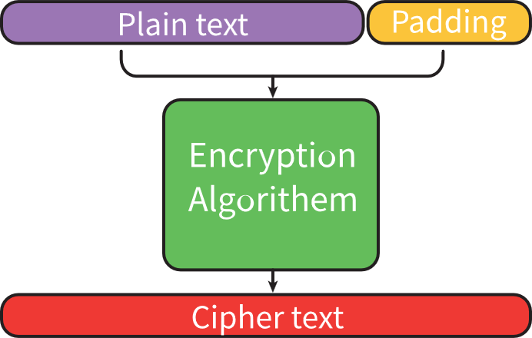
Lab 07: CBC padding
The target of this exploitation is to get the plain text from the a given cipher text
The exploit make use of the way the data is padded before encryption
In this lab a cipher text is given and the plain text is required to be driven
Here we will use a server that decrypt the cipher text, check the padding and return either the process was successful or it failed

Slide 25
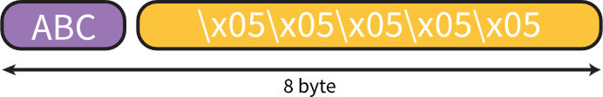
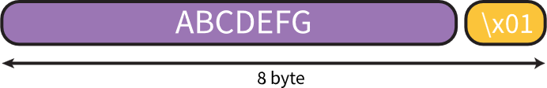
PKCS7
Most block cipher uses PKCS7 for padding.
In PKCS7 the value to pad with is the number of bytes of padding that are required.
So if we have block cipher algorithm with 8 byte block size

Slide 26
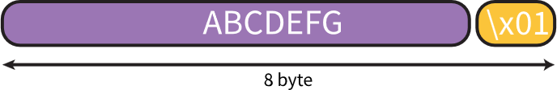
PKCS7
If the string is a multiple of the block size, an empty block of only padding is appended.
To distinguish between the string “ABCDEFG\x01” as a data from “ABCDEFG” (the
Here “\x01” is not padding it is a part of the string.

Slide 27
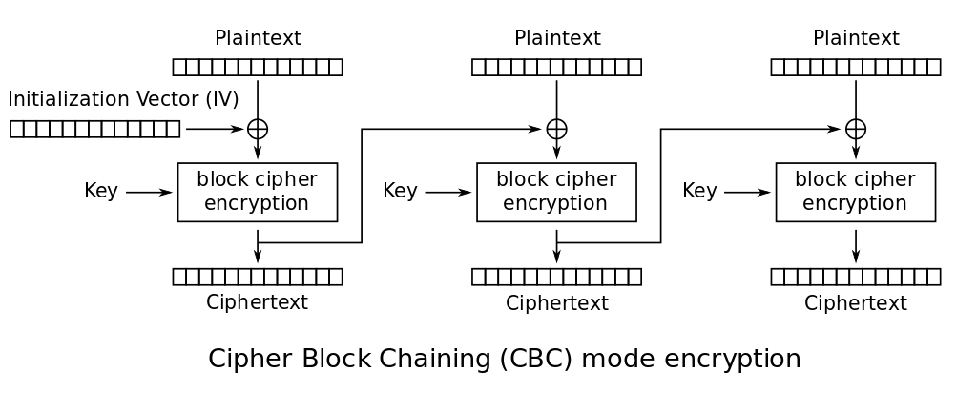





CBC encryption
$$P1$$
$$Pn$$
$$IV$$
$$C1$$
$$Cn$$
$$C1 = E(P1 ⊕ IV)$$
$$Cn = E\left(Pn ⊕ Cn−1\right) for→n > 1$$

Slide 28

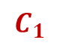




CBC encryption
.
$$P_{n}$$
$$P_{1}$$
$$IV$$
$$C_{1}$$
$$C_{n}$$
$$C_{1} = E(P_{1} ⊕ IV)$$
$$C_{n} = E\left(P_{n} ⊕ C_{n−1}\right) for→n > 1$$

Slide 29
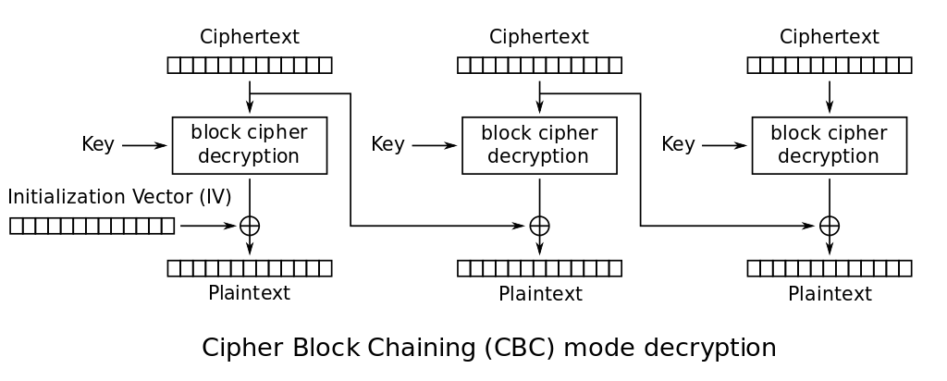






CBC decryption
.
$$C_{n}$$
$$C1$$
$$IV$$
$$P_{1}$$
$$P_{n}$$
$$P_{1} = D(C_{1}) ⊕ IV$$
$$P_{n} = D\left(C_{n}\right)⊕ C_{n−1} → for all n > 1$$

Slide 30
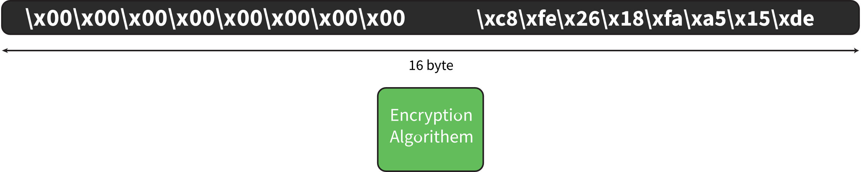
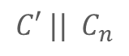
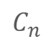
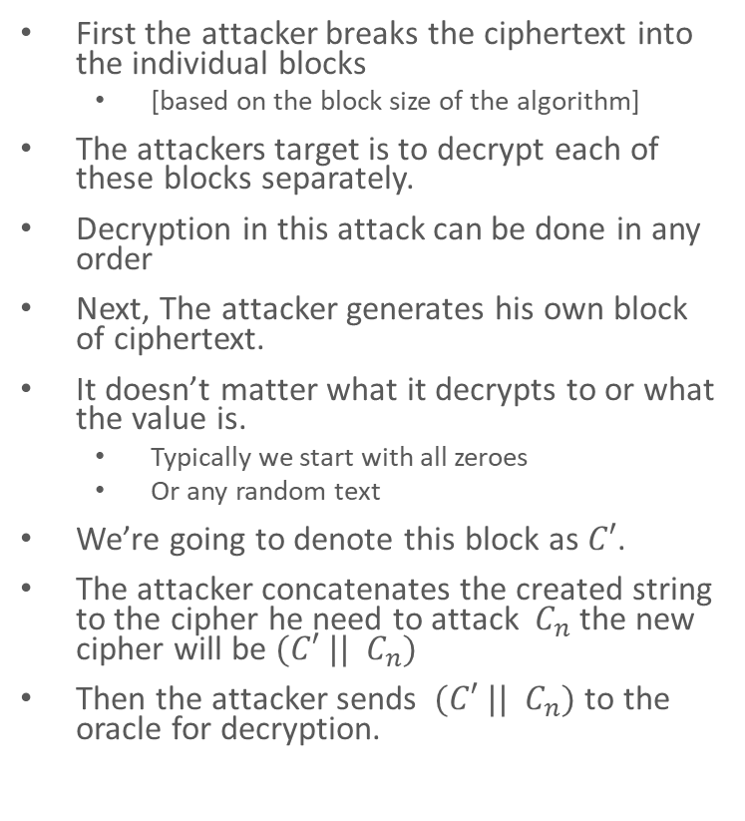
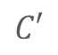
Attacking CBC
$$C′$$
$$C_{n}$$
First the attacker breaks the ciphertext into the individual blocks
[based on the block size of the algorithm]
The attackers target is to decrypt each of these blocks separately.
Decryption in this attack can be done in any order
Next, The attacker generates his own block of ciphertext.
It doesn’t matter what it decrypts to or what the value is.
Typically we start with all zeroes
Or any random text
We’re going to denote this block as $C′$.
The attacker concatenates the created string to the cipher he need to attack $C_{n}$ the new cipher will be $(C′ || C_{n})$
Then the attacker sends $(C′ || C_{n})$ to the oracle for decryption.
$$C′ || C_{n}$$

Slide 31
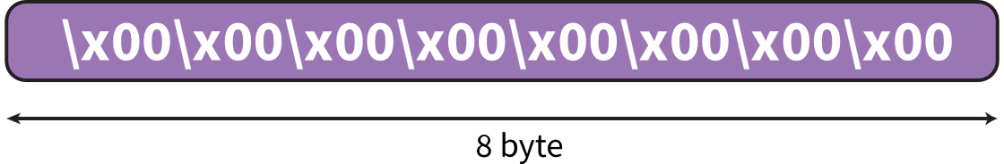
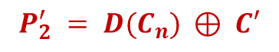


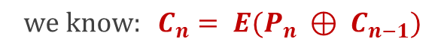



Attacking CBC
$$C′$$
$$C_{n}$$
$$P_{1}^{′} = D(C′) ⊕ IV$$
$$P_{2}^{′} = D(C_{n}) ⊕ C′$$
$$Garbage$$
$$we know: C_{n}= E(P_{n} ⊕ C_{n−1})$$
$${so :P}_{2}^{′} = D(E(P_{n} ⊕ C_{n−1})) ⊕ C′$$
$${so :P}_{2}^{′} = P_{n} ⊕ C_{n−1} ⊕ C′$$

Slide 32




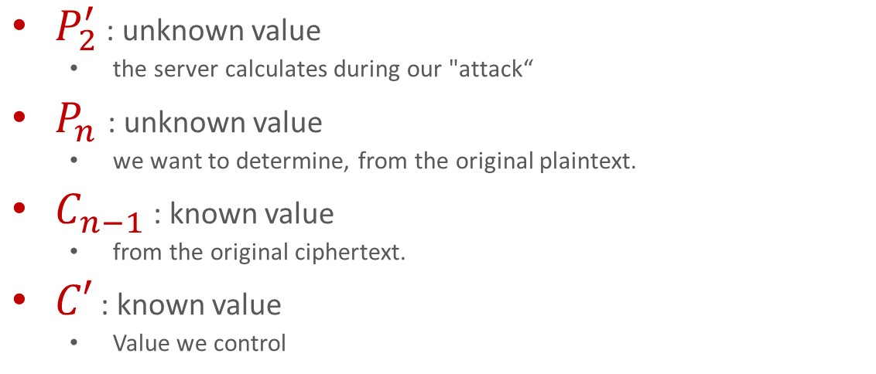

Attacking CBC
$$C_{n}$$
$$C′$$
For this equation
$$P_{2}^{′} = P_{n} ⊕ C_{n−1} ⊕ C′$$
$P_{2}^{′}$ : unknown value
the server calculates during our "attack“
$P_{n}$ : unknown value
we want to determine, from the original plaintext.
$C_{n−1}$ : known value
from the original ciphertext.
$C′$ : known value
Value we control
$$P_{2}^{′} = P_{n} ⊕ C_{n−1} ⊕ C′$$

Slide 33






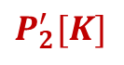
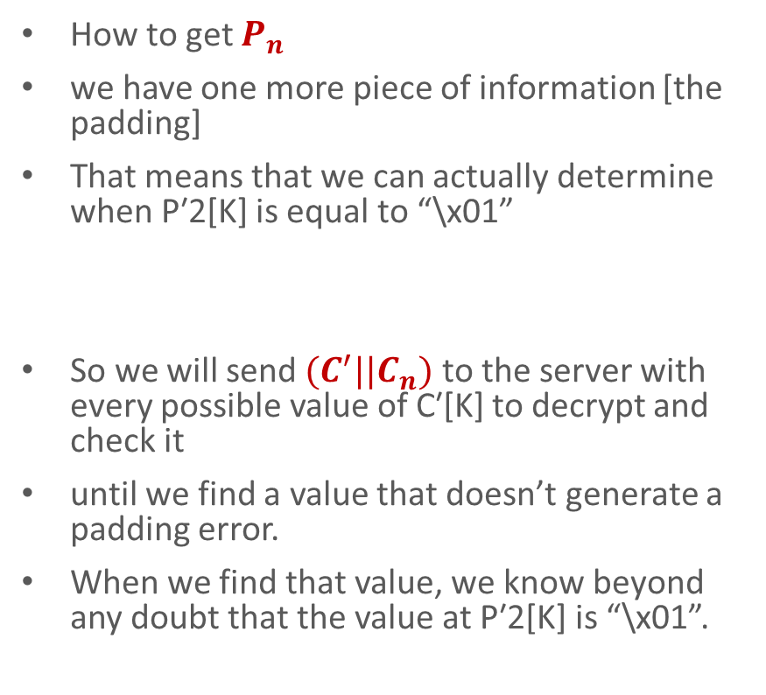
Attacking CBC
$$C_{n}$$
$$C′[K]$$
$$C′$$
How to get $P_{n}$
we have one more piece of information [the padding]
That means that we can actually determine when P′2[K] is equal to “\x01”
So we will send ${(C}^{′}||C_{n})$ to the server with every possible value of C′[K] to decrypt and check it
until we find a value that doesn’t generate a padding error.
When we find that value, we know beyond any doubt that the value at P′2[K] is “\x01”.
Try
Another
Value
$$P_{2}^{′}[K] = P_{n}[K] ⊕ C_{n−1} [K] ⊕ C′[K]$$
invalid padding
Valid padding
$$P_{n}= \backslash x01$$
$$P_{2}^{′}[K]$$
$$P_{2}^{′} = P_{n} ⊕ C_{n−1} ⊕ C′$$

Slide 34
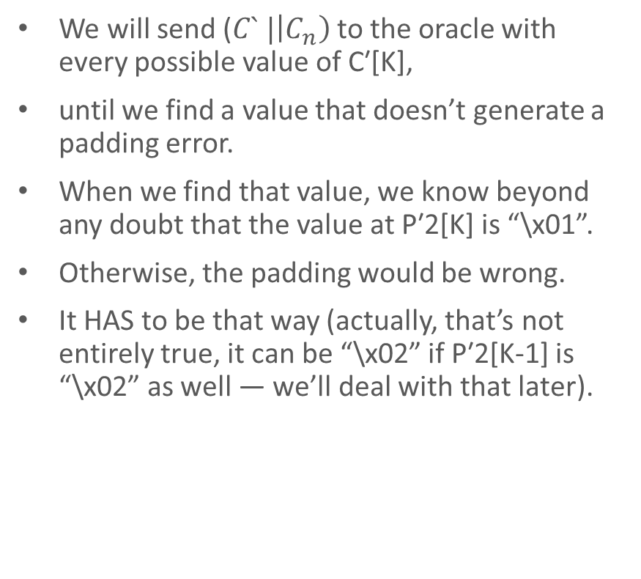
Attacking CBC
$$C_{n}$$
$$C′[K]$$
$$C′$$
We will send ($C` |\left|C_{n}\right)$to the oracle with every possible value of C′[K],
until we find a value that doesn’t generate a padding error.
When we find that value, we know beyond any doubt that the value at P′2[K] is “\x01”.
Otherwise, the padding would be wrong.
It HAS to be that way (actually, that’s not entirely true, it can be “\x02” if P′2[K-1] is “\x02” as well — we’ll deal with that later).
Try
Another
Value
invalid padding
Valid padding
$$P_{n}= \backslash x01$$
$$P_{2}^{′}[K]$$
$$P_{2}^{′} = P_{n} ⊕ C_{n−1} ⊕ C′$$

Slide 35


Lab 08: CTR Bit flipping
Given
A program running on a server. The server takes input from the user Replace the “;” with “?” Add an arbitrary string before and after the input Then Encrypts it using a block-cipher encryption in CTR mode Returns the corresponding ciphertext as the output of the program
Needed
Manipulate the given cipher text so that when the system decrypts it gives the desired plain text to access the system

Slide 36
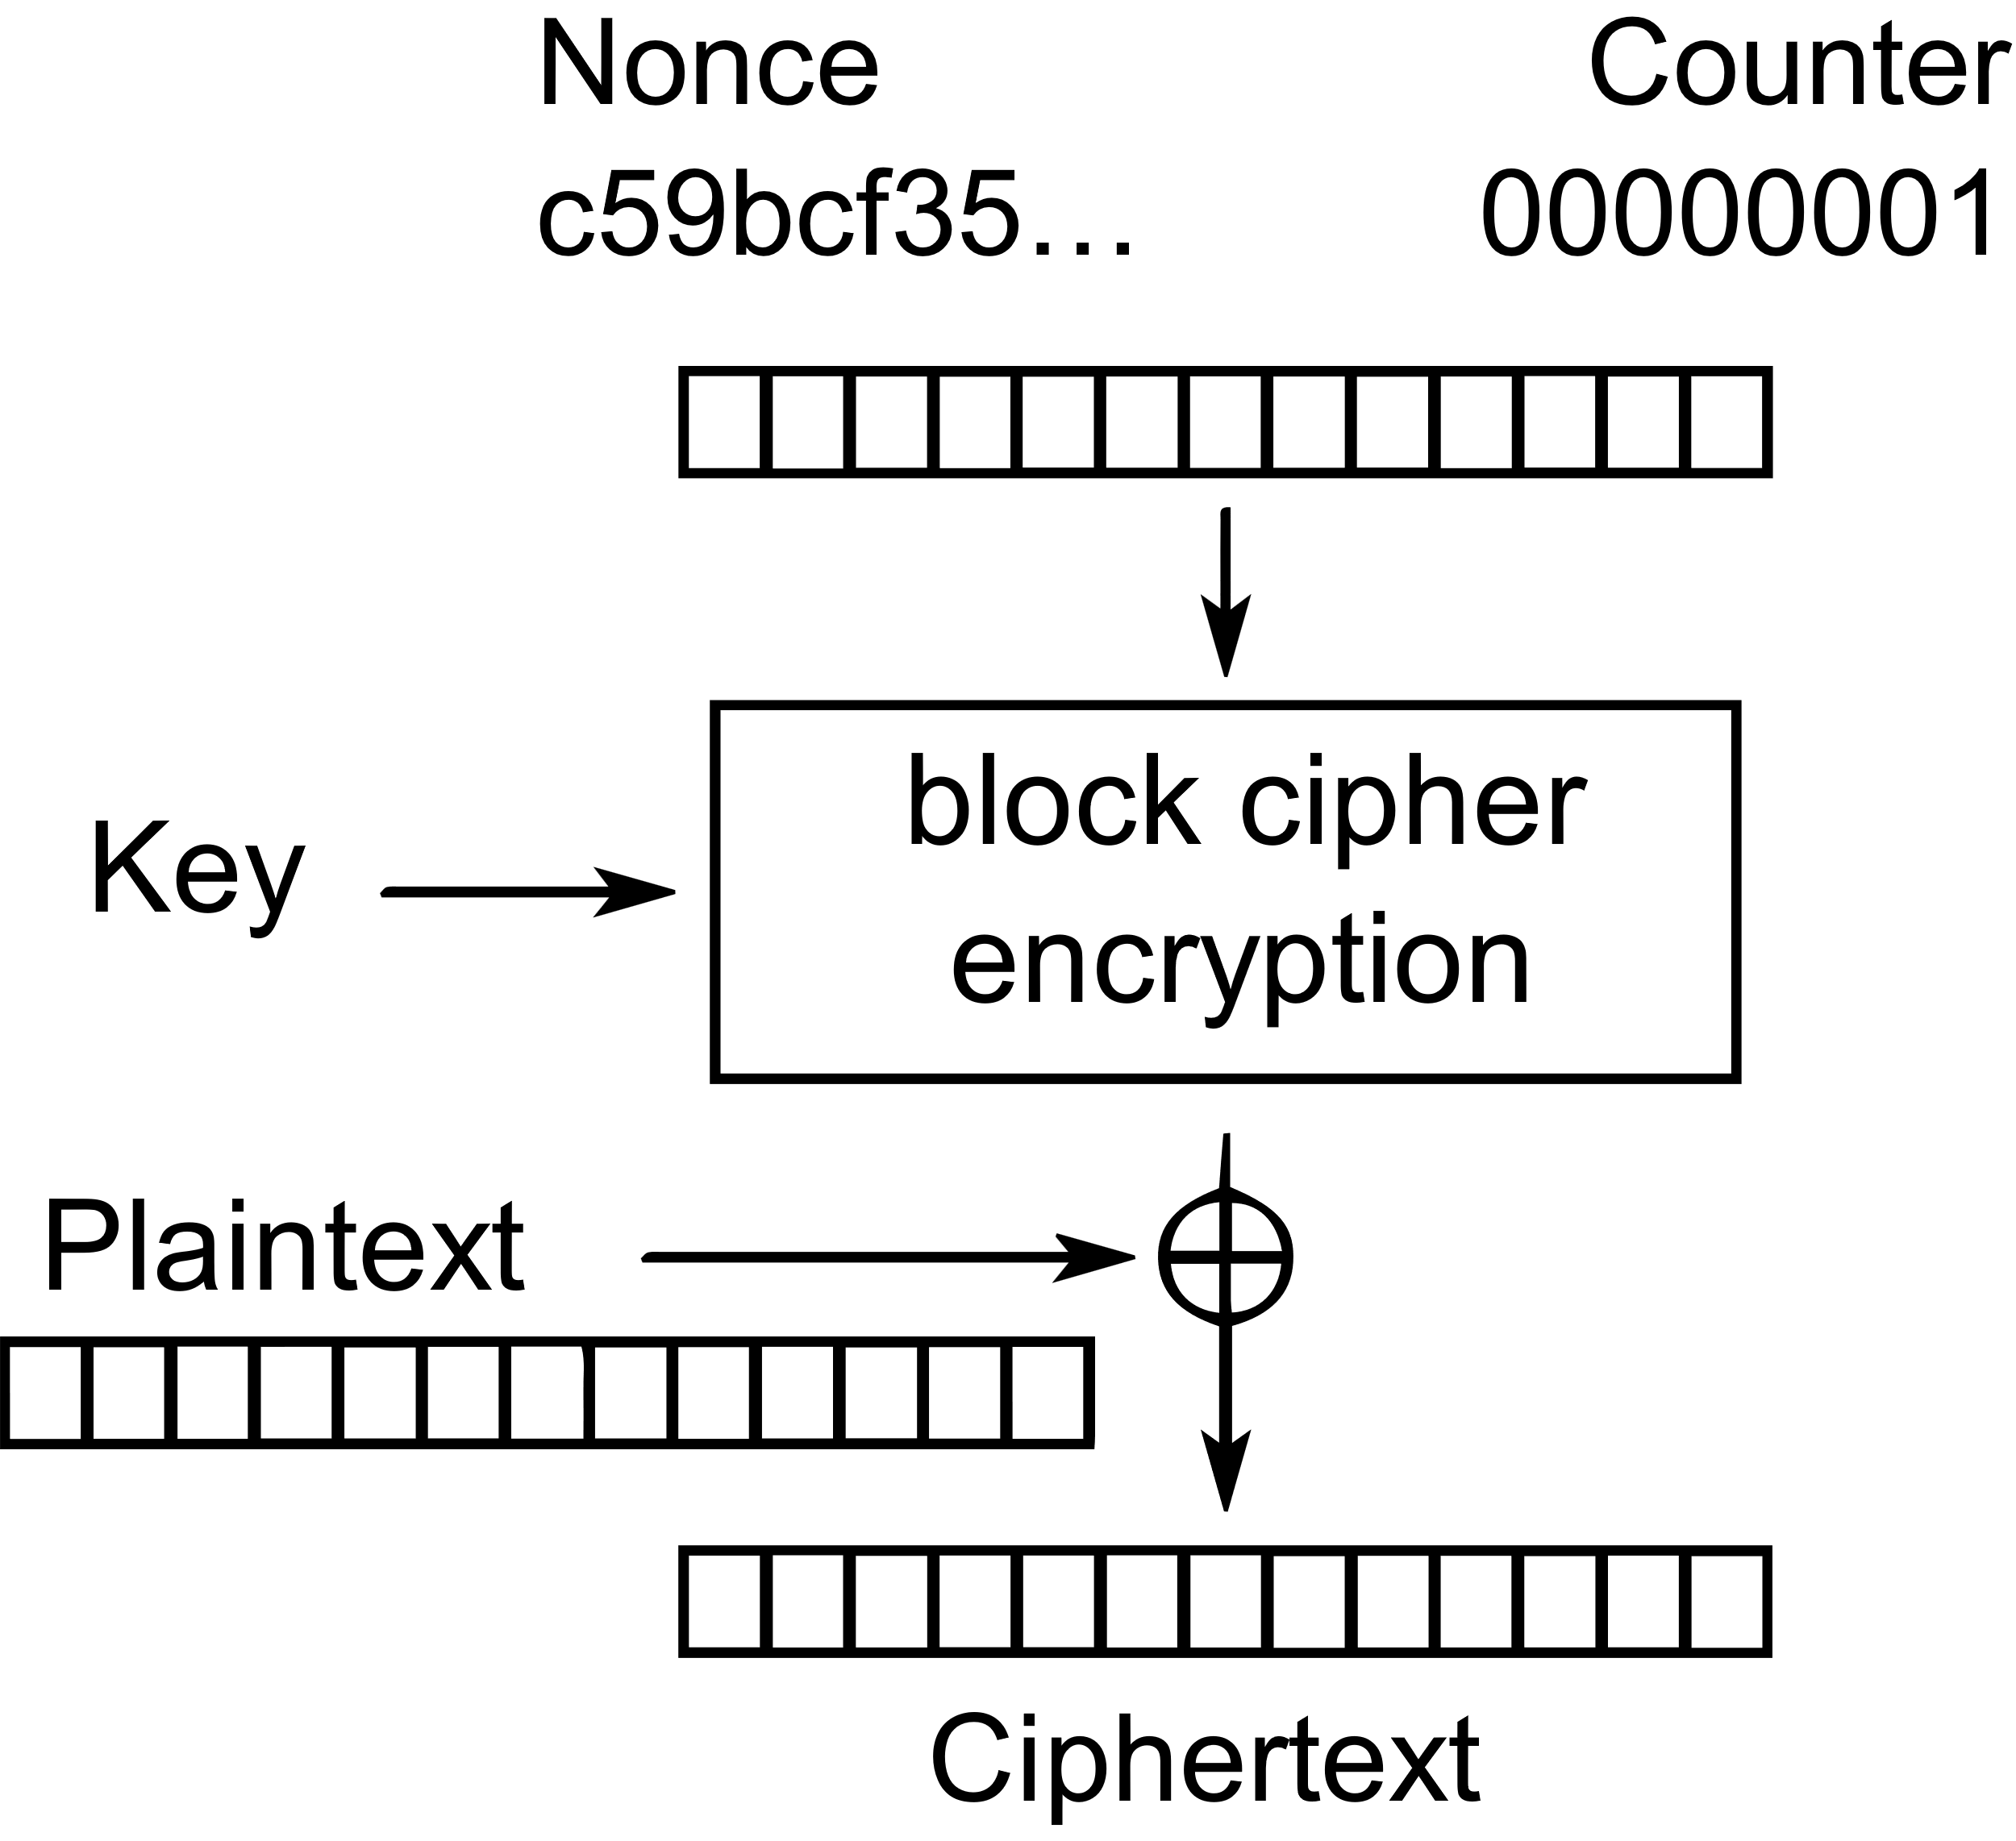





Lab 08: CTR Bit flipping
Exploit
the ciphertext of the respective block is xored with encryption of nonce+counter to give plaintext of the respective block. This can be written for each block as (C is the ciphertext block, P is the plaintext block and D() is the decryption oracle:
$C = E(nonce + counter)⨁P$
For the nth byte of the block we can write
$C[n] = E(nonce + counter)[n]⨁P[n]$
By re-arranging the equation
$E(nonce + counter)[n] =C[n]⨁P[n]$
$E(nonce + counter)[n]$ is always constant so if we change $C\left[n\right],$ the $P[n]$ will change
$$E(nonce + counter)$$
$$P$$
look at the decryption oracle again E(nonce + counter)[n] = C[n] xor PF[n] ----> PF because we want it to be a fixed plaintext block (reason above) Therefore we can write, C[n] = C[n] xor PF[n] xor PD[n] ----> PD is the value of plaintext desired
$$C$$

Slide 37



Lab 08: CTR Bit flipping
Exploit
So if we want the plain text after decryption to be$PD$ [in our case it will be “=”], we can write $C[n]$to be Where $PF$ is the value of the plaintext that is already present in it [in our case it will be “?”] And $C`[n]$ is resultant ciphertext we will send to be decrypted
$$C`[n] = C[n]⨁PF[n]⨁PD[n]$$
$$C`[n] = C[n]⨁"?"⨁"="$$

Slide 38



Disclaimer
Please note that this session is for educational purposes only, I hold no responsibility for any unexpected car disappearances in Egypt. Let's keep the learning light-hearted and the cars where they belong!.
😅😅😅

Slide 39

Thank you

